Slide 1
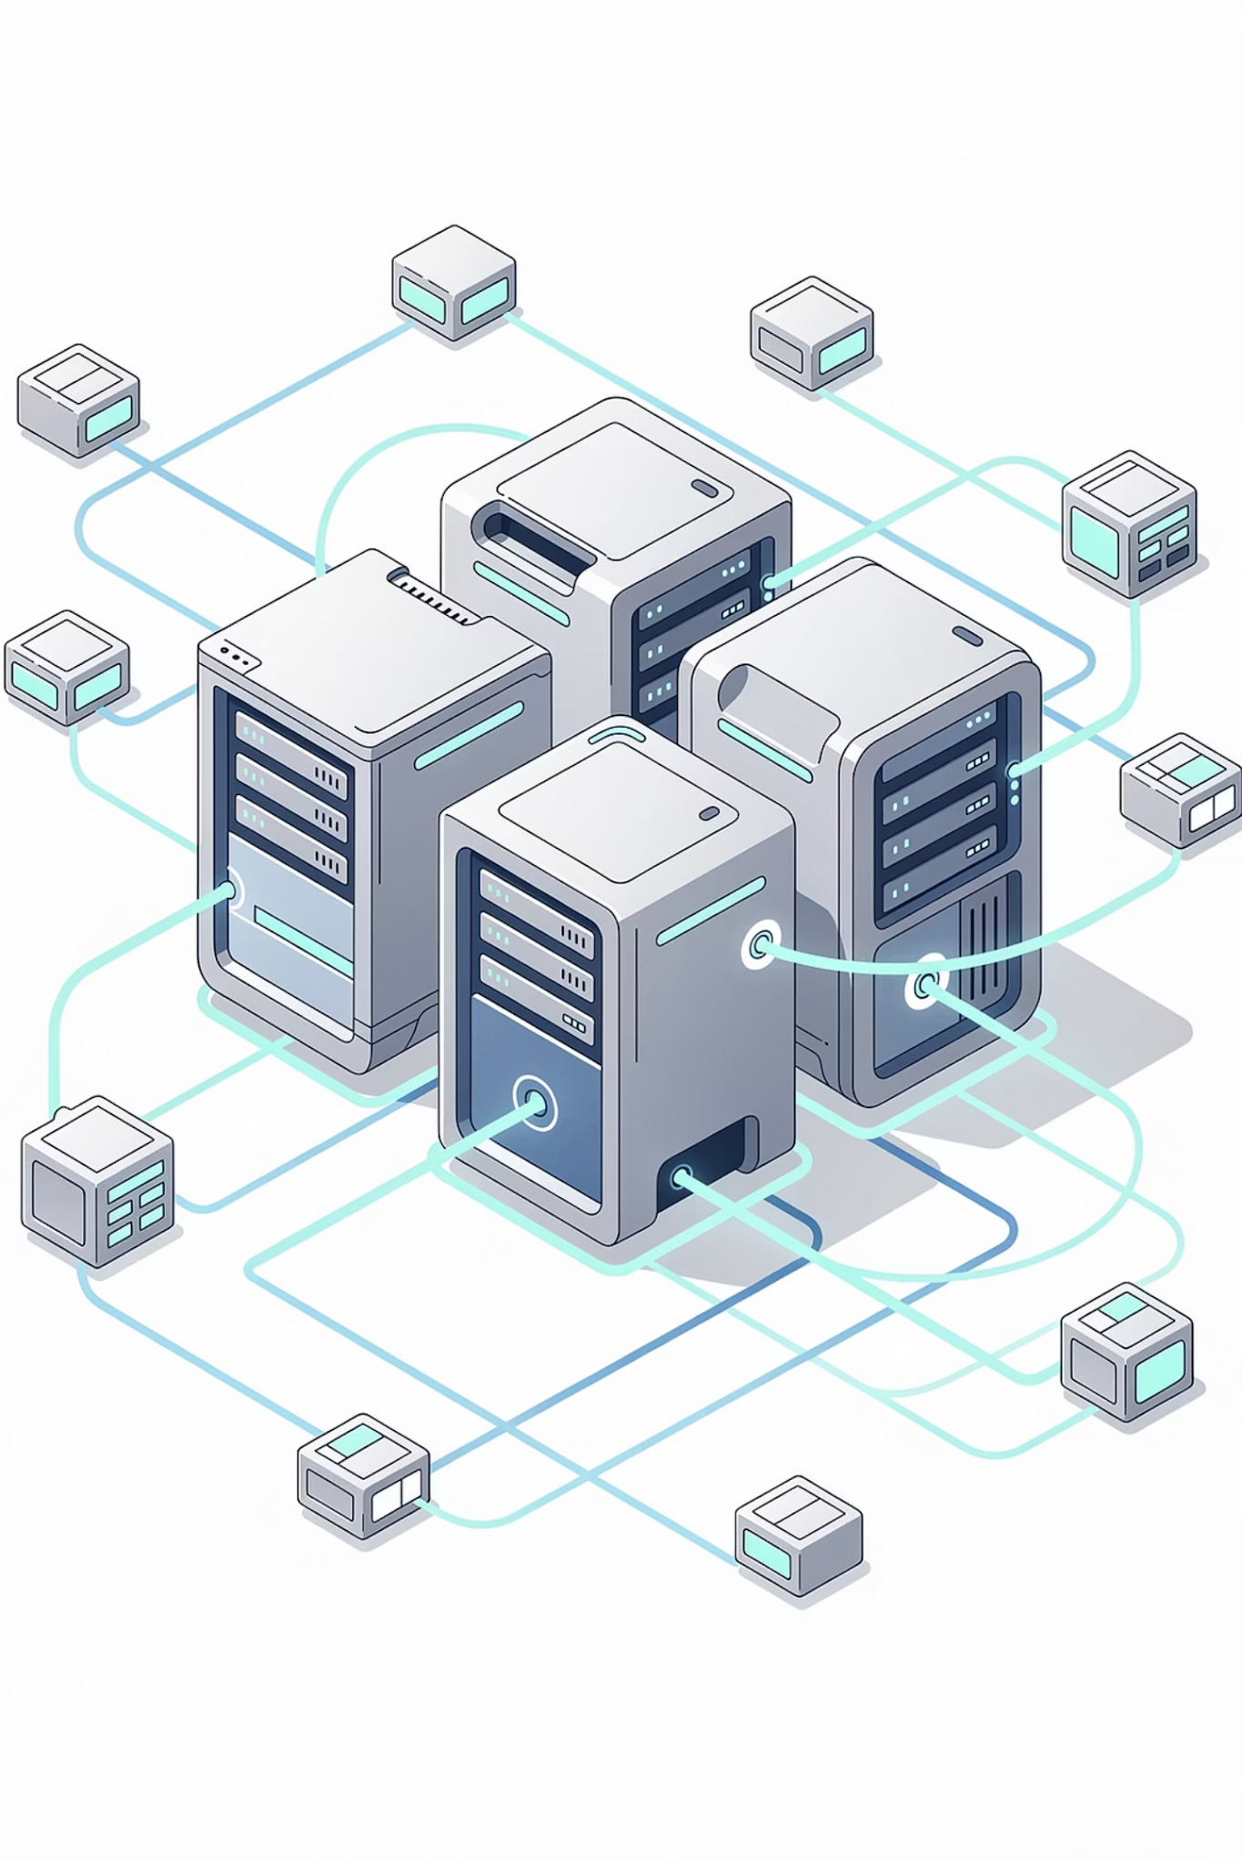

Microservices, Culture & Career Roadmap
From Architecture to Career Growth
1

Slide 2
Session Agenda
01
02
Monolithic vs Microservices
API Communication Basics
03
04
DevOps Culture
Continuous Improvement
05
06
Real-World Scaling Examples
Architecture Diagrams
07
08
Startup vs Enterprise DevOps
Career Roadmap 2026
2

Slide 3
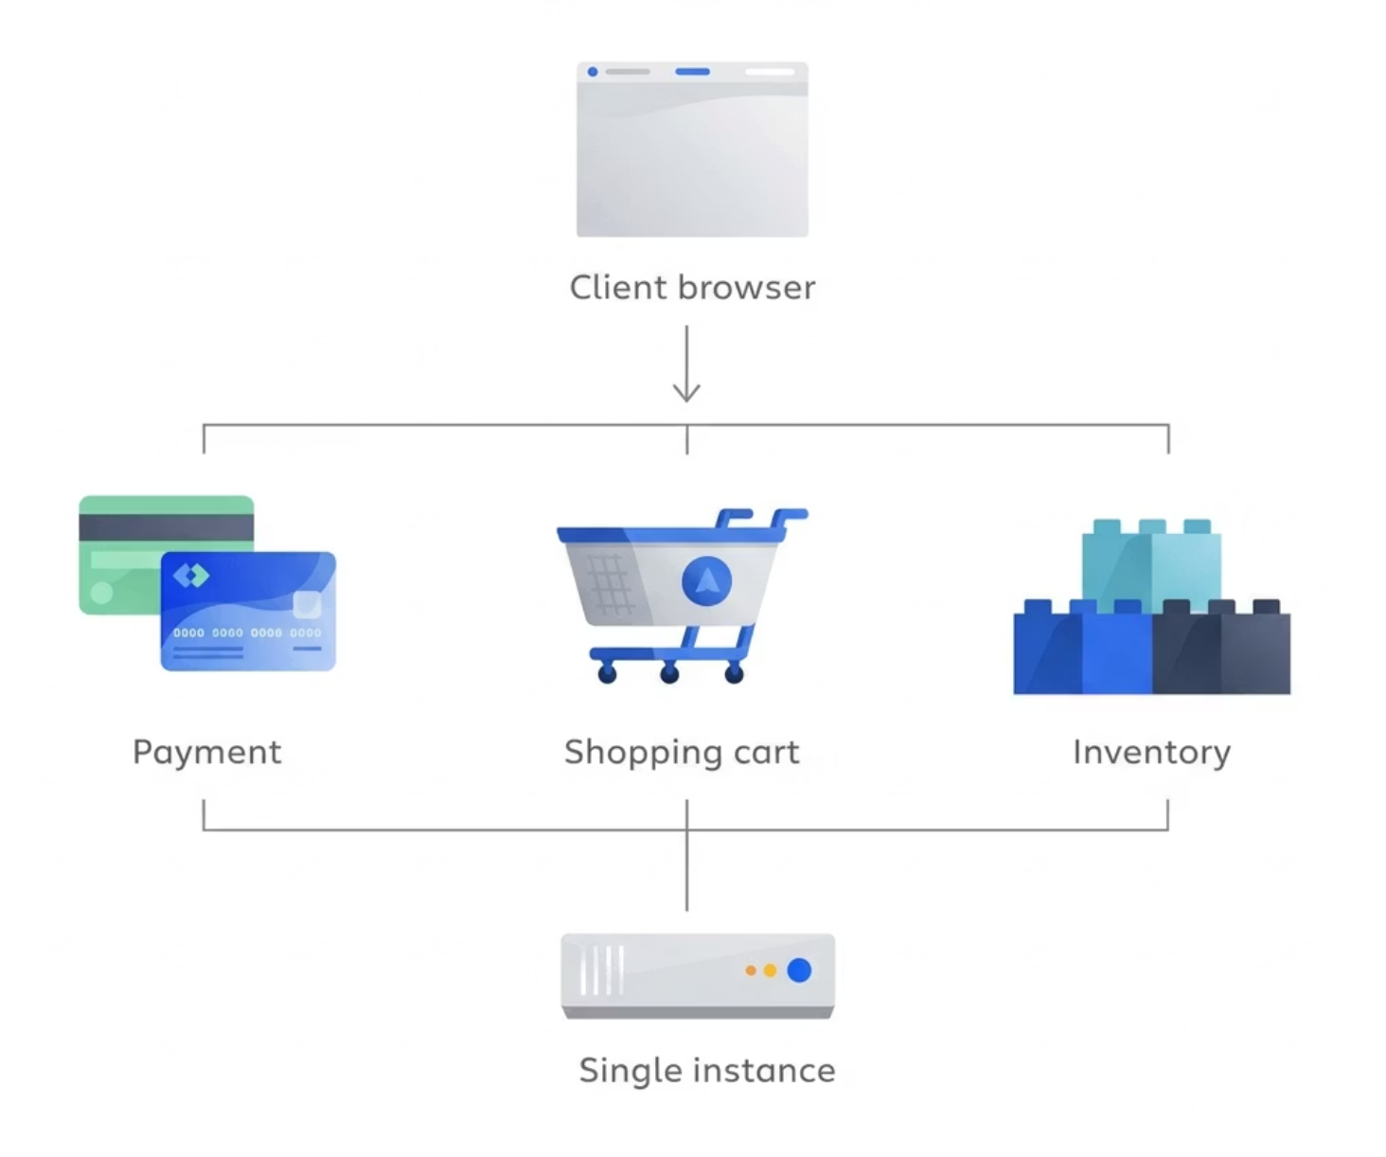
CONCEPT INTRODUCTION
What is Monolithic Architecture?
A single codebase deployed as one unit — all features tightly coupled together.
All modules live inside one application.
Example:
User Module
Payment Module
Order Module
3

Slide 4
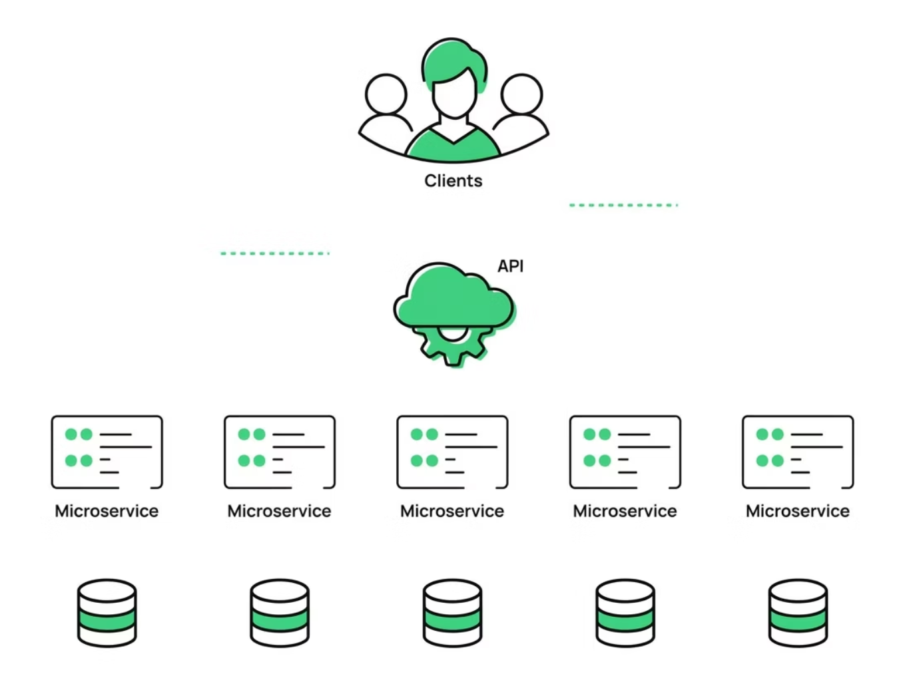
CONCEPT INTRODUCTION
What is Microservices Architecture?
Microservices architecture:
Application split into small services
Each service independently deployable
Communicate via APIs
User Service
Payment Service
Order Service
4

Slide 5
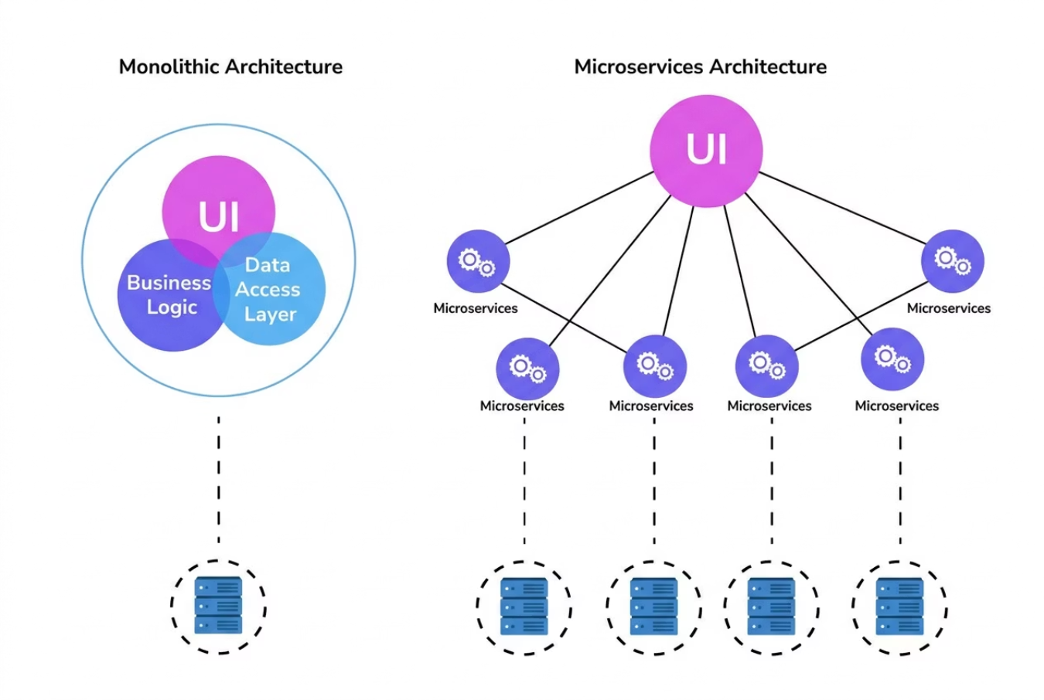

CONCEPT INTRODUCTION
Monolithic vs Microservices
Monolithic
Microservices
Single deployment
Multiple deployments
Tight coupling
Loose coupling
Hard to scale specific part
Scale services independently
Simple to start
Complex to manage
Key Insight: Monolith = Simpler to start.
Microservices = Scalable but complex.
5

Slide 6





CONCEPT INTRODUCTION
Challenges of Microservices
Network Latency
Service Discovery
Distributed Logging
Debugging Complexity
Deployment Coordination
Microservices increase operational complexity significantly.
6

Slide 7
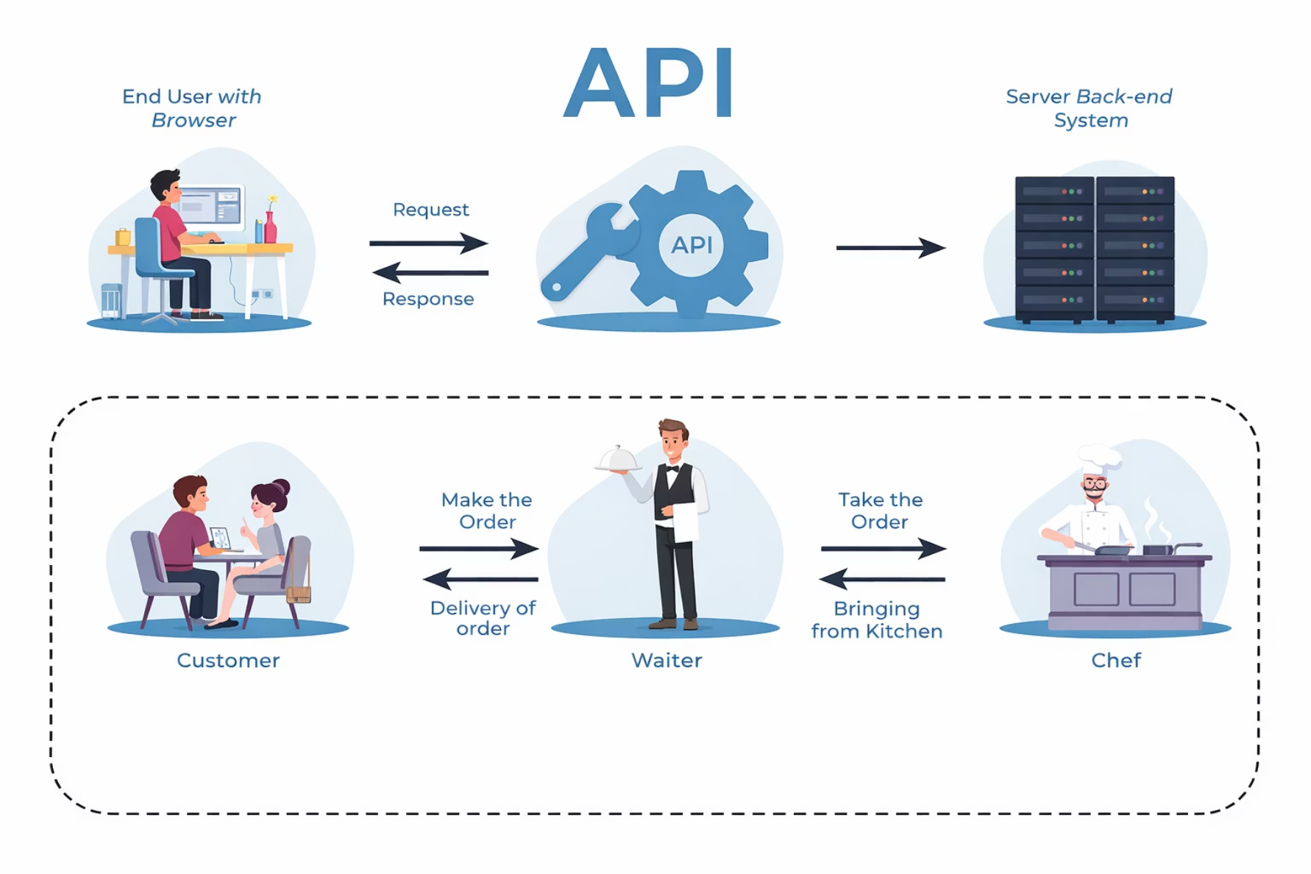
API COMMUNICATION BASICS
What is an API?
API = Application Programming Interface
It allows services to talk to each other.
User Service → asks Payment Service → "Process Payment"
7

Slide 8
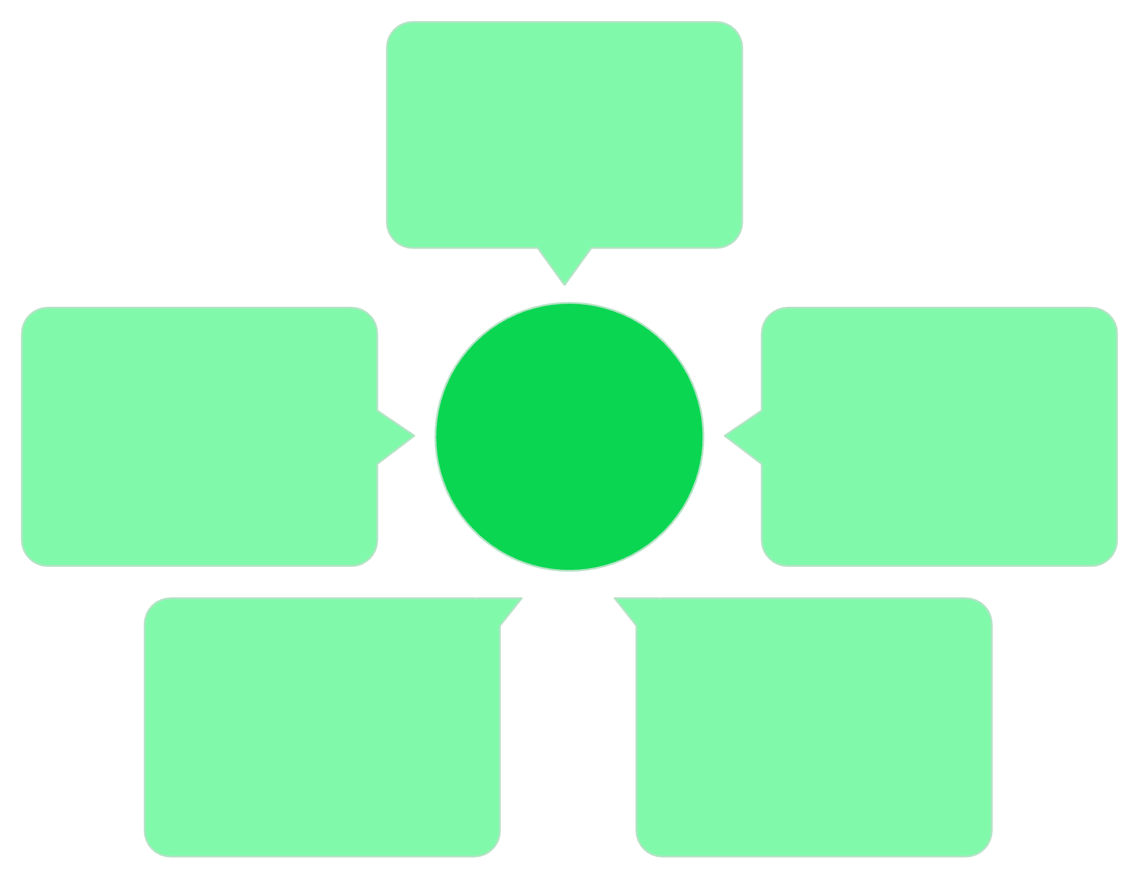

API COMMUNICATION BASICS
API Gateway Concept
Client Request
The API Gateway acts as a single entry point instead of clients calling each service directly.
External client call
Authentication Layer
Microservices
API Gateway
Authentication
Individual backend services
Validate tokens and credentials
Rate Limiting Control
Routing Layer
Routing
Rate Limiting
Forward to appropriate service
Throttle excessive requests
8

Slide 9




API COMMUNICATION BASICS
How Microservices Communicate
REST APIs / HTTP
Message Queues
Event-Driven
Standard request-response over HTTP/HTTPS
Async communication via brokers like Kafka or RabbitMQ
Services react to events published by other services
Communication must be secure, reliable, and monitored.
9

Slide 10

DEVOPS CULTURE
What is DevOps Culture?
DevOps is not just tools — it's a mindset of
Collaboration
Shared responsibility
Fast feedback
Automation and continuous learning.
Dev + Ops + Security working together
10

Slide 11
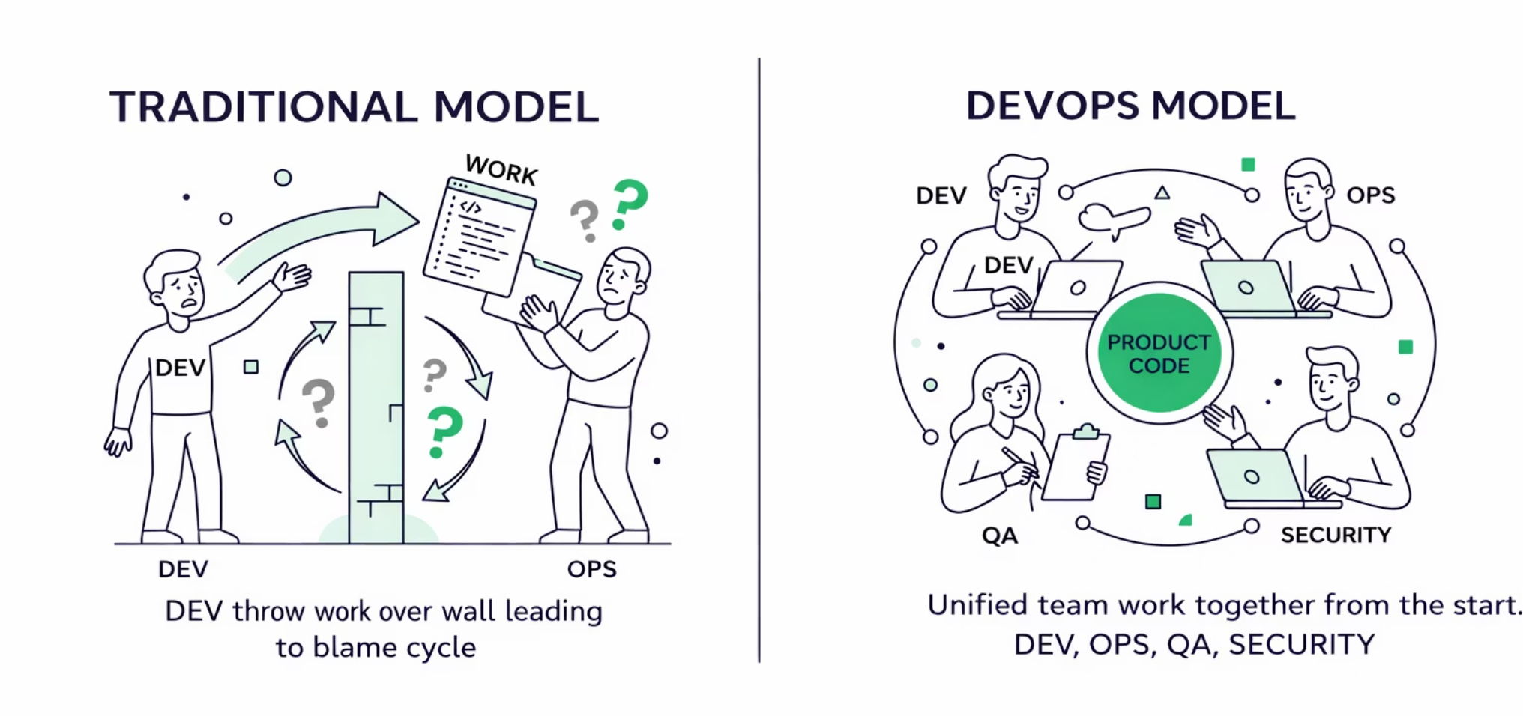
DEVOPS CULTURE
Cross-Team Collaboration Model
Traditional:
DevOps:
Dev → Throw to Ops → Blame cycle
Dev + Ops + QA + Security
Working together from the start.
11

Slide 12



DEVOPS CULTURE
Continuous Improvement Mindset
Automate Repetitive Tasks
Reduce Deployment Time
Improve Monitoring
Learn from Incidents
Key Idea: Small improvements daily → Big growth over time.
12

Slide 13
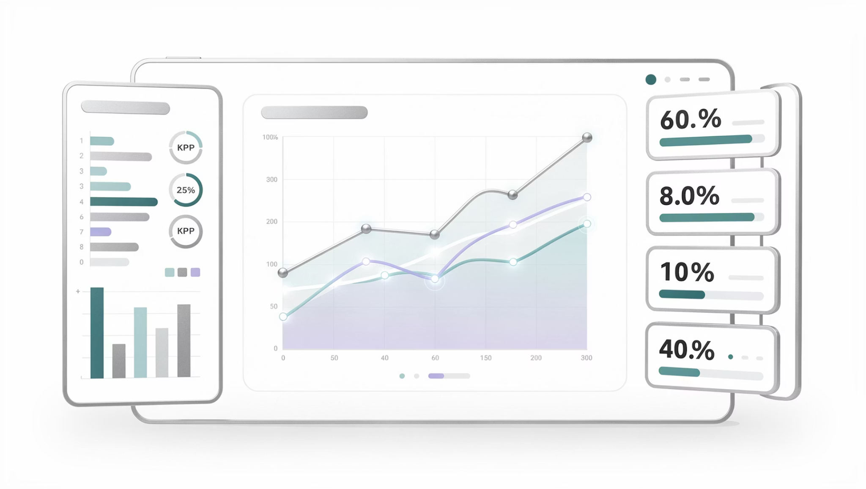
DEVOPS CULTURE
Observability in Microservices
Monitoring becomes harder in microservices. Need:
Without observability, troubleshooting becomes very difficult.
Centralized Logging
Distributed Tracing
Metrics Aggregation
13

Slide 14
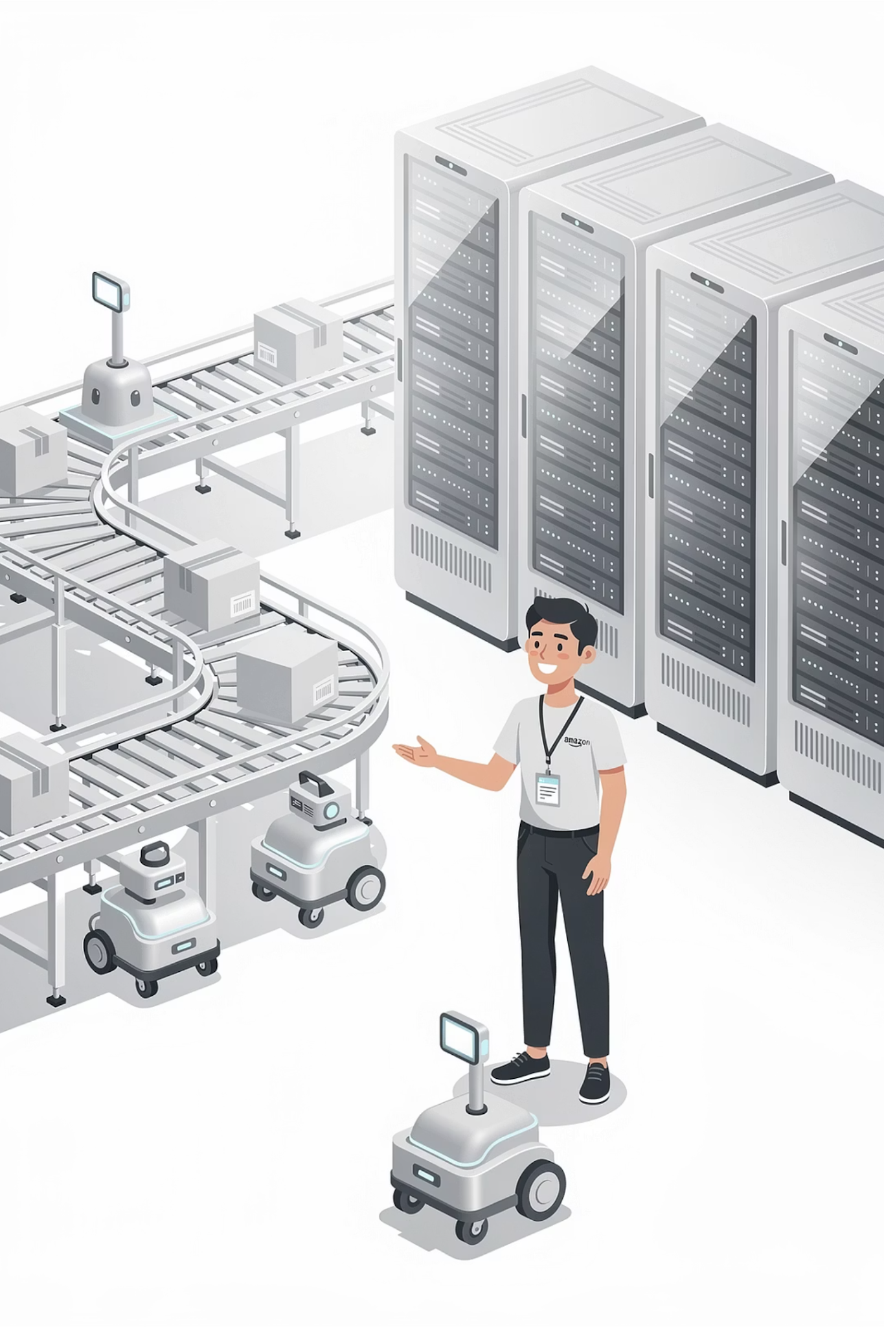

REAL-WORLD EXAMPLES
Architecture Evolution at Amazon
1
Early Stage
Monolithic systems handling all operations
2
Traffic Growth
Moved to service-based architecture
3
At Scale
Independent teams per service, scalable infrastructure
Lesson: Architecture evolves with scale.
14

Slide 15
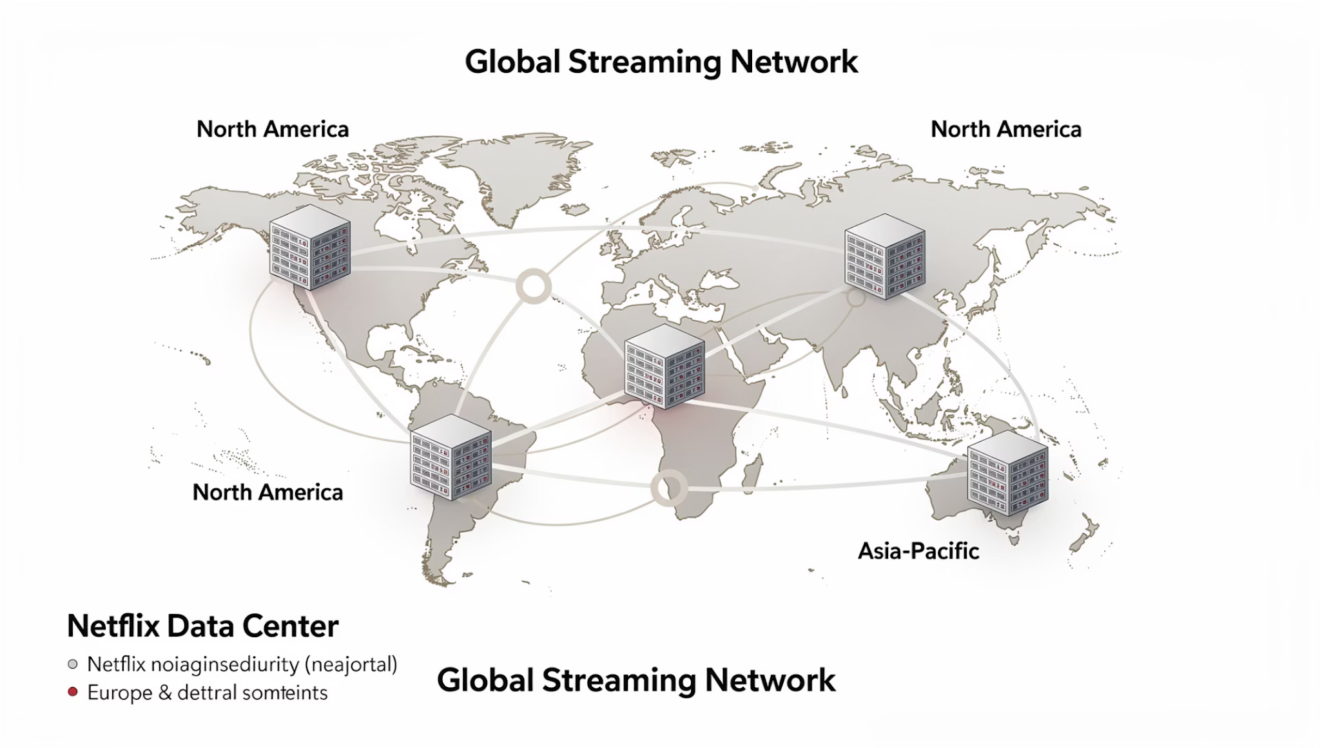

REAL-WORLD EXAMPLES
Microservices Model at Netflix
Challenges
Massive global traffic
High availability requirements
Solution
Microservices
Cloud Infra
Auto-Scaling
Lesson: Microservices support global scale.
15

Slide 16
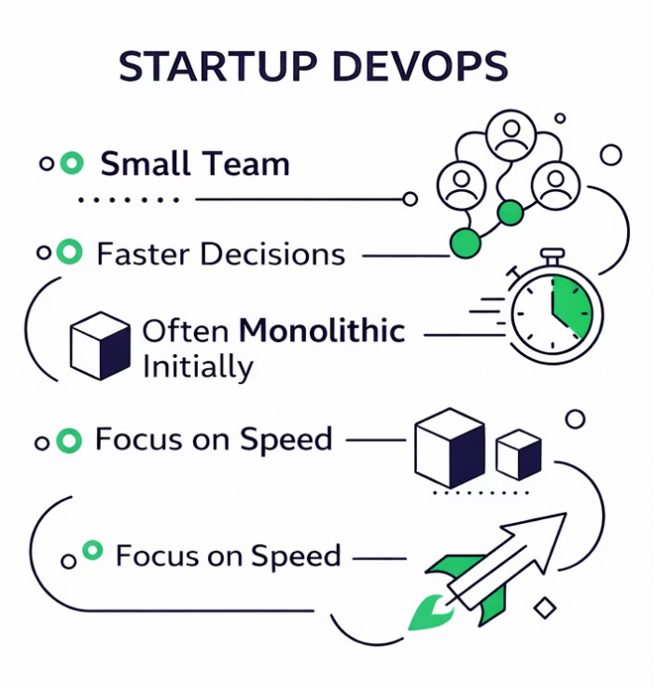
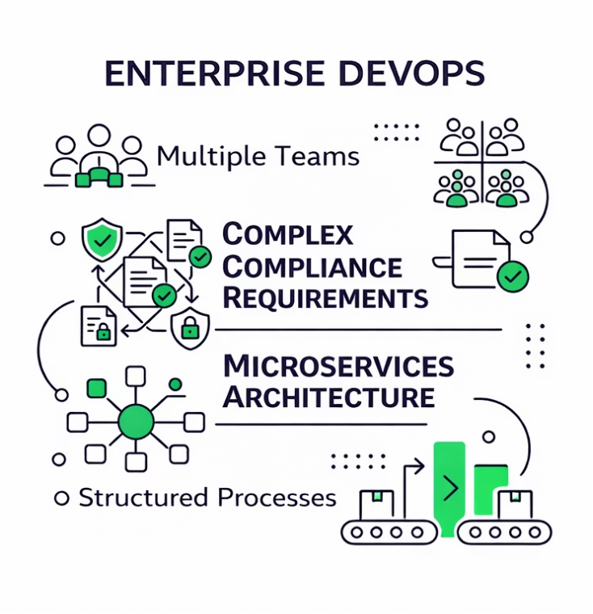
REAL-WORLD EXAMPLES
DevOps in Startups vs Enterprises
Startup:
Enterprise:
Small team
Faster decisions
Often monolithic initially
Focus on speed
Multiple teams
Complex compliance
Microservices
Structured processes
Different sizes require different strategies — there is no one-size-fits-all approach.
16

Slide 17
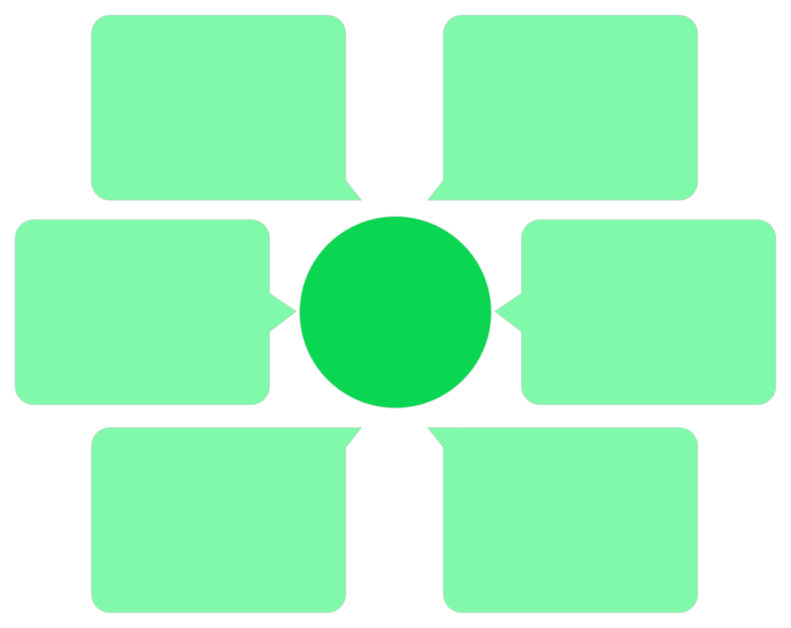
ARCHITECTURE DIAGRAM
Microservice Communication Diagram
Order DB
User
Own service database
Client initiating request
Order Service
API Gateway Entry
API Gateway
Processes orders
Single entry point
User DB
User Service
Own service database
Handles user data
Each service is independent with its own database. The API Gateway serves as the single entry point for all client requests.
17

Slide 18
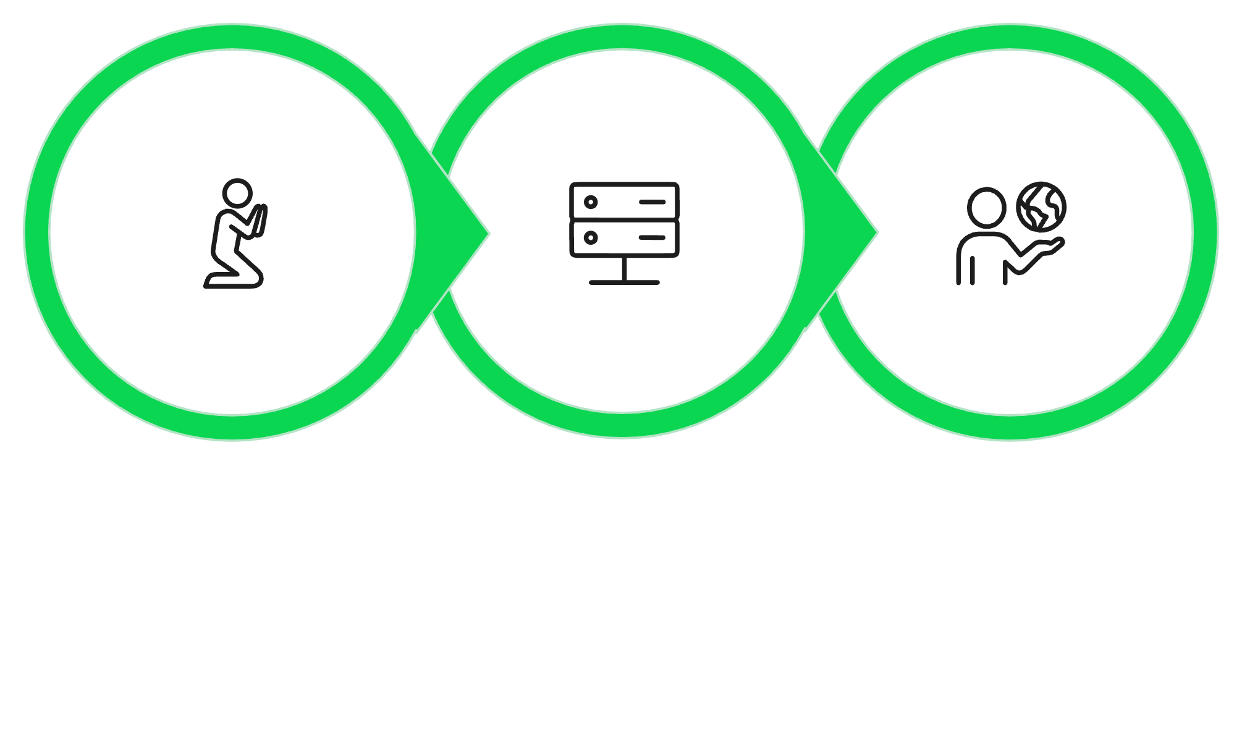

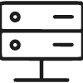

ARCHITECTURE DIAGRAM
API Communication Flow
Client Request
Service Process
JSON Response
Every API interaction follows the pattern: Request → Processing → Response.
18

Slide 19
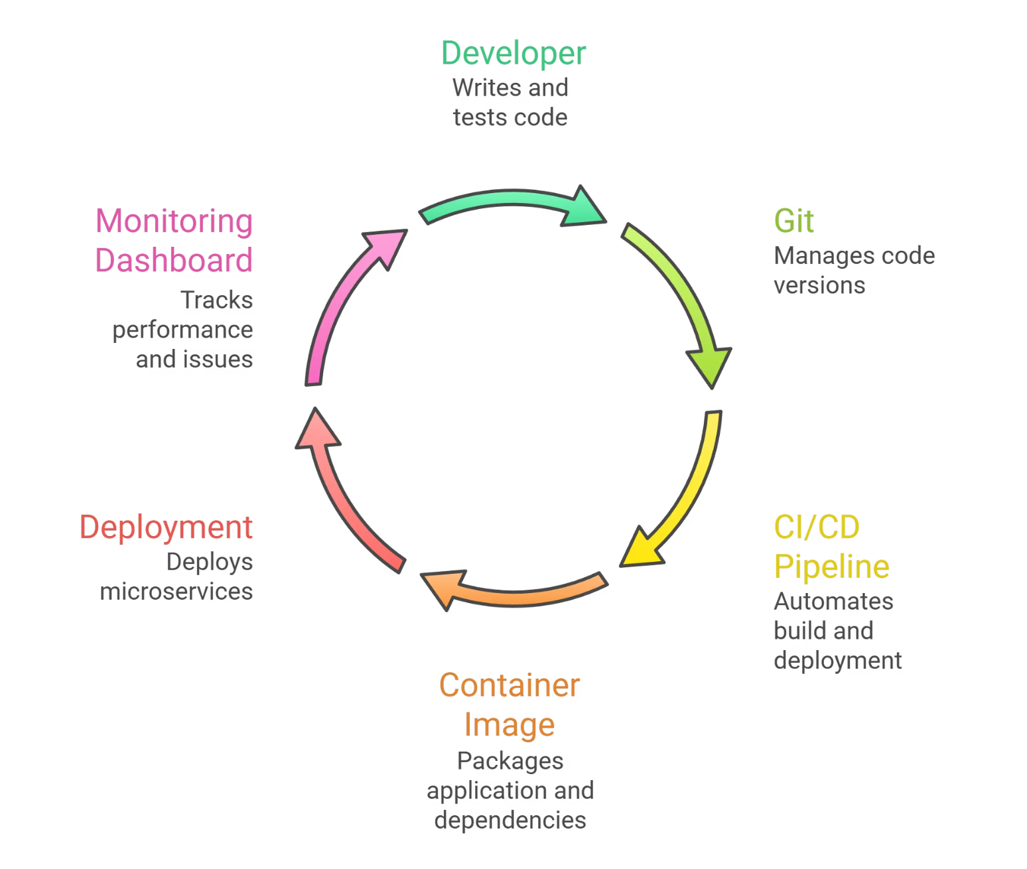
ARCHITECTURE DIAGRAM
Full DevOps Lifecycle
This diagram shows the full DevOps lifecycle integration — from code commit to production monitoring.
19

Slide 20
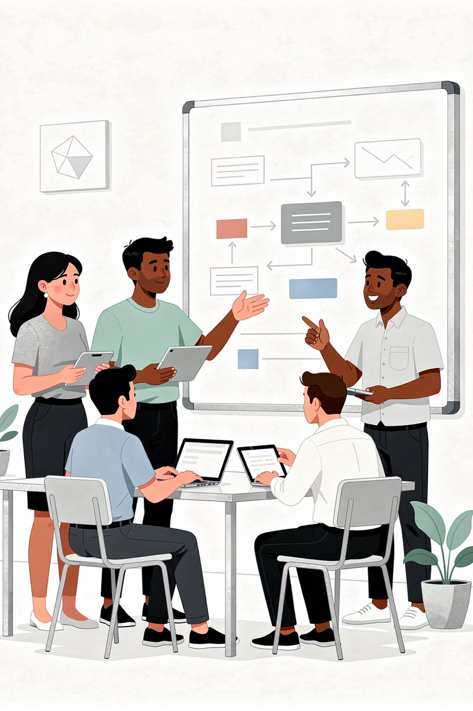
DISCUSSION
Should Small Startups Use Microservices?
Pros
Cons
Future scalability
Independent scaling per service
Operational complexity
Requires strong DevOps maturity
Higher infrastructure cost
Conclusion: Start simple → Evolve to microservices when needed.
20

Slide 21



CAREER ROADMAP
DevOps Career Roadmap: Beginner to Advanced
Stage 1 – Foundation
Linux · Git · Networking Basics · Cloud Basics
Stage 2 – Intermediate
CI/CD · Containers · Infrastructure as Code · Monitoring
Stage 3 – Advanced
Microservices · Kubernetes · Security Automation · Observability · SRE
21

Slide 22
CAREER ROADMAP
Skills Required in 2026
Technical Skills
Soft Skills
Cloud Platforms
Containers
Communication
Problem-Solving
CI/CD Pipelines
Monitoring & Observability
Collaboration
Continuous Learning
Security Awareness
Automation Scripting
DevOps = Technical + Cultural skills.
22

Slide 23






CAREER ROADMAP
DevOps Career Specializations (2026)
Cloud Engineering
Site Reliability Engineering (SRE)
DevSecOps
Platform Engineering
Infrastructure Automation
Observability Engineering
Future demand: Automation + Cloud + Security + Reliability
23

Slide 24
DISCUSSION
Final Reflection Questions
1
2
Are microservices always better?
Can culture matter more than tools?
3
4
Should you specialize or be broad in DevOps?
What skills will remain future-proof?
Encourage open discussion and share your perspective.
24

Slide 25
Congratulations! 🎉
You now understand the full DevOps landscape — from Linux & Git to Microservices, CI/CD, Cloud, Security, Monitoring, and Career Planning.
Linux & Git
Cloud & CI/CD
Microservices
DevOps Culture
Career Roadmap
You are ready to build real-world DevOps projects.
25

Slide 26


Thank You
26

